Slide 1
Collaborative Platform Version 5.0
Team Members
Product Owner
Adrian Alfonso
Juan Caraballo
Jorge Travieso

Slide 2
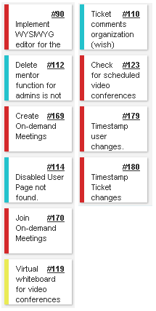
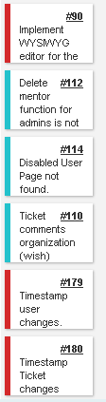
Sprint 2 Stories
My Sprint 2 Stories
Done and approved
Done and approved
Done and approved
Done and approved
Total 76 pts
Done and approved
Total 40pts
Done and approved

Slide 3
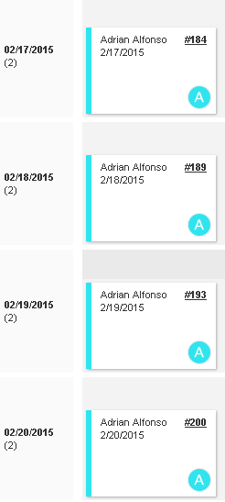
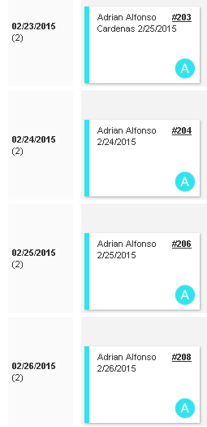
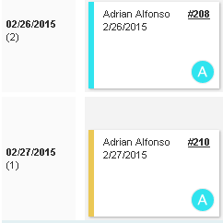
Daily Scrums

Slide 4
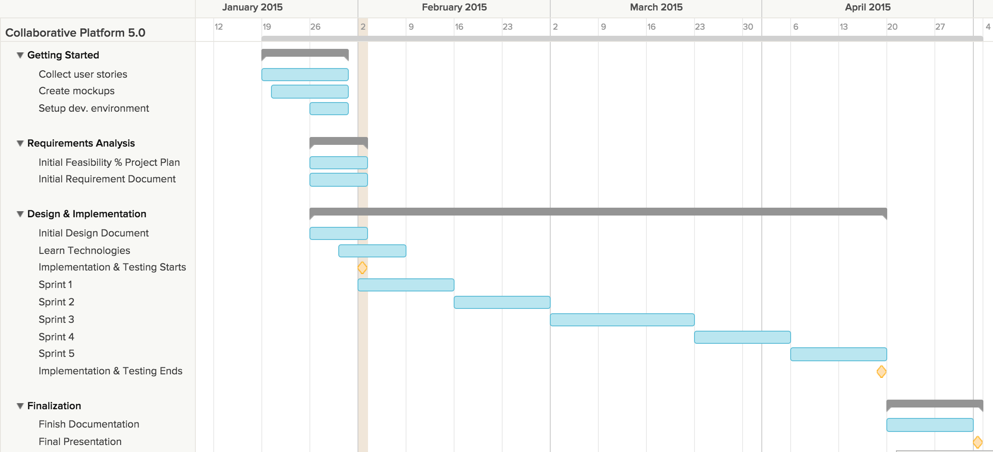
Project plan

Slide 5
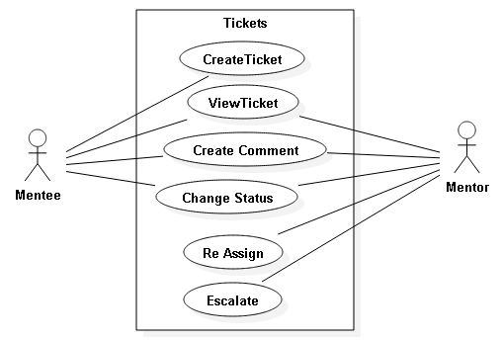
Use Cases Modified

Slide 6
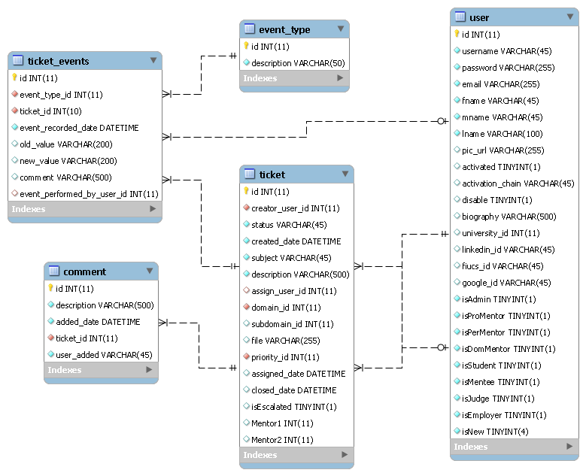
ER Diagram

Slide 7
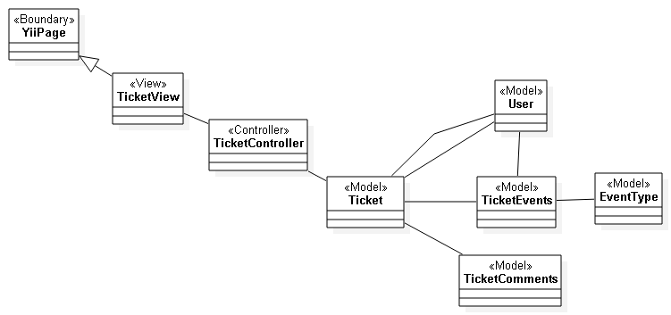
Class Diagram (Ticket Events)

Slide 8
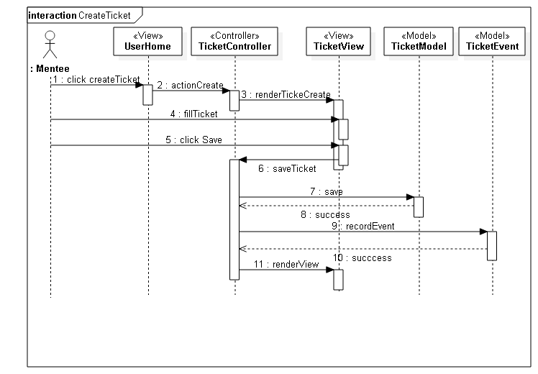
Sequence Diagram (Create Ticket)

Slide 9
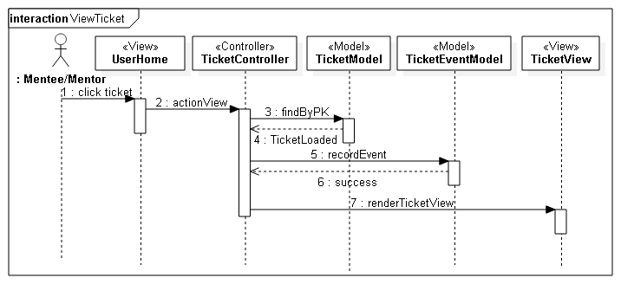
Sequence Diagram (View Ticket)

Slide 10
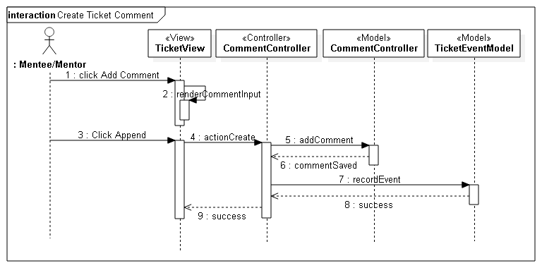
Sequence Diagram (Create Comment)

Slide 11
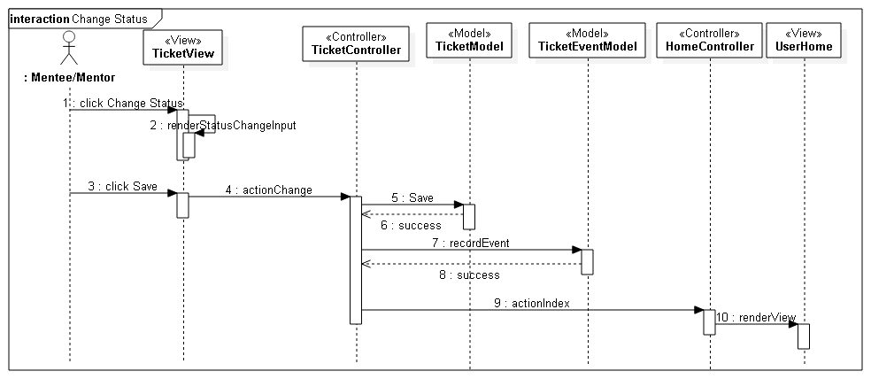
Sequence Diagram (Change Status)

Slide 12
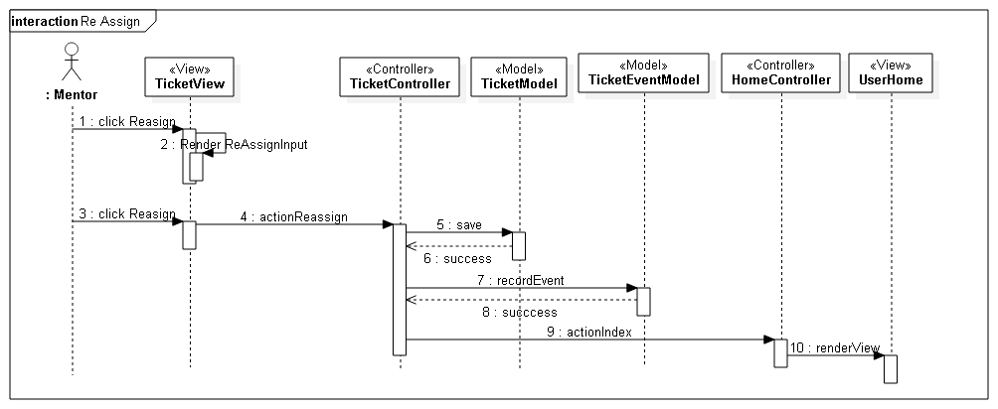
Sequence Diagram (Re Assign)

Slide 13
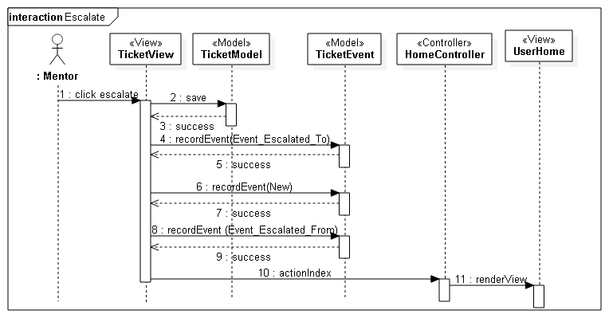
Sequence Diagram (Escalate)

Slide 14
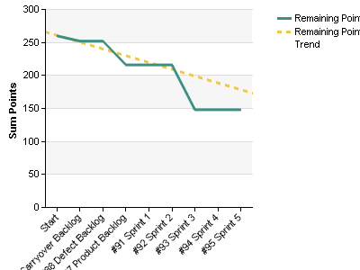
Burndown chart

Slide 15
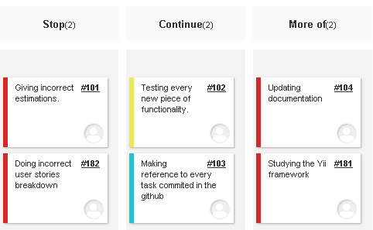
Retrospective

Slide 16
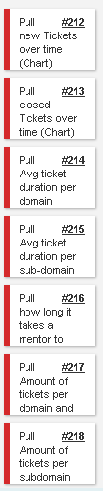
Sprint 3 Stories
Total 40 pts

